Slide 1
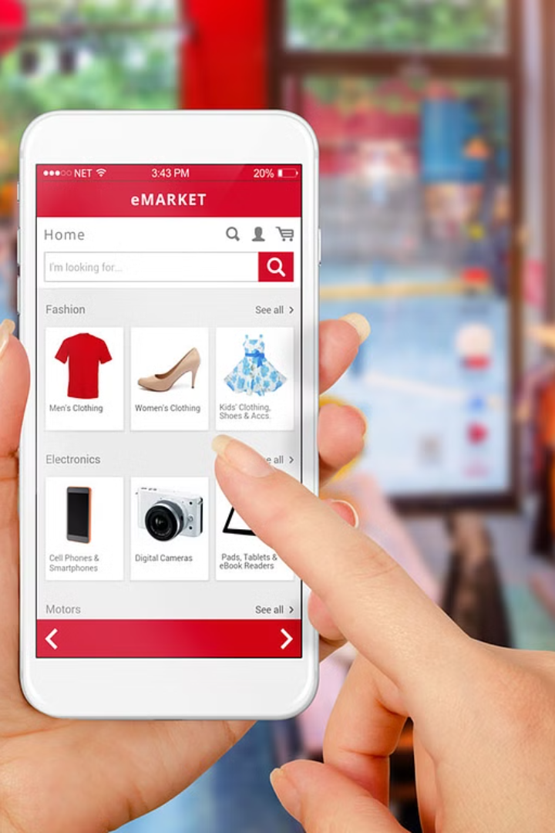
Thrifty: A Smart Way to Reuse & Resell
Thrifty is a revolutionary online thrift marketplace where users can list second-hand items and negotiate prices with potential buyers. Imagine OLX meets real-time bidding, but with a clean UI and an emphasis on responsible reuse and resale.

Slide 2

The Problem with Traditional Thrifting
One-Sided Transactions
Limited Visibility & Power
Buyers are often left with a binary choice: accept the listed price or walk away. This can lead to frustration for both parties.
Sellers may not get fair offers or enough exposure for their items, while buyers may miss out on hidden treasures.

Slide 3
ThriftSmart: A Game-Changing Solution
1
Interactive Negotiation
2
More Control for Sellers
ThriftSmart empowers buyers to negotiate prices, creating a dynamic and engaging experience.
Sellers have greater control over pricing and can strategically accept or counter offers.
3
Community-Driven Engagement
The platform fosters a sense of community by encouraging conversation and fostering a sense of shared value.

Slide 4


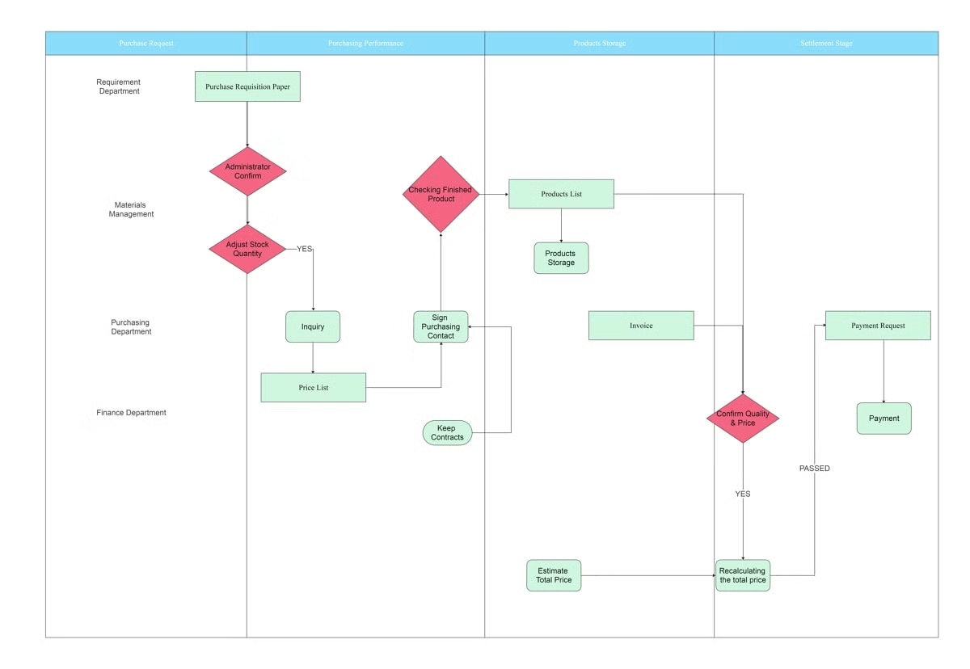



The ThriftSmart User Flow
Seller Lists Item
Sellers upload their item, add photos, and set a base price.
Buyer Sends Offer
Buyers submit their own offers, sparking negotiation.
Seller Responds
Sellers accept, reject, or counter offers, creating dynamic engagement.
Buyer Pays
If accepted, the buyer pays securely via the platform, completing the transaction.

Slide 5

The Benefits of ThriftSmart
Sellers
Buyers
Thrifty
Increased visibility for their items
Greater control over pricing
Monetization through commissions
Access to better deals than fixed-price platforms
Flexible control over pricing
Building a trusted community through user feedback and analytics
Faster selling through negotiation
An enjoyable and engaging shopping experience
Growth through user engagement and word-of-mouth

Slide 6





The Future of ThriftSmart
AI Price Suggestion Engine
Verified Seller Badges
Logistics & Delivery Integration
Mobile App & Chat Negotiation
Helps sellers price items competitively based on market data.
Boosts seller credibility and builds trust among buyers.
Provides convenient and efficient delivery options for buyers.
Offers real-time messaging for seamless negotiation and communication.

